Slide 1


Slide 2
RECAP: DATA BASE MANAGEMENT
What is a database?
A database is an organized collection of data.
What is a Database Management System?
Database management systems (DBMSs) are specially designed software applications that interact with the user, other applications, and the database itself to capture and analyze data.

Slide 3


Slide 4
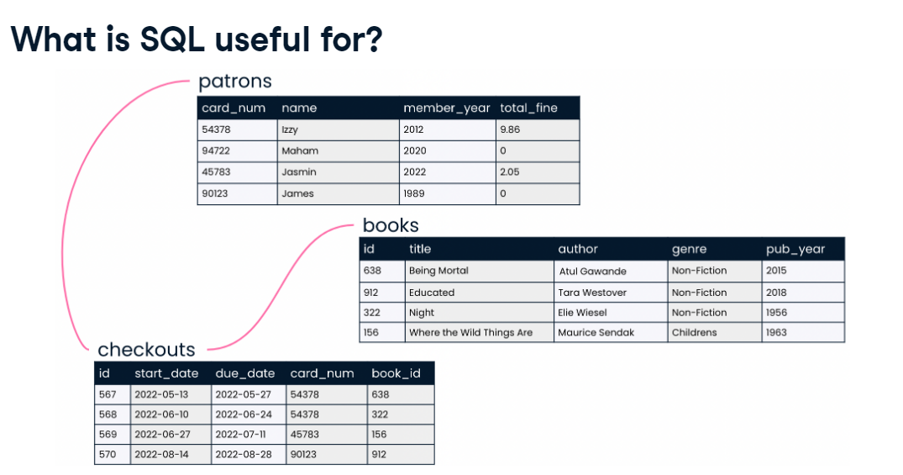

Slide 5
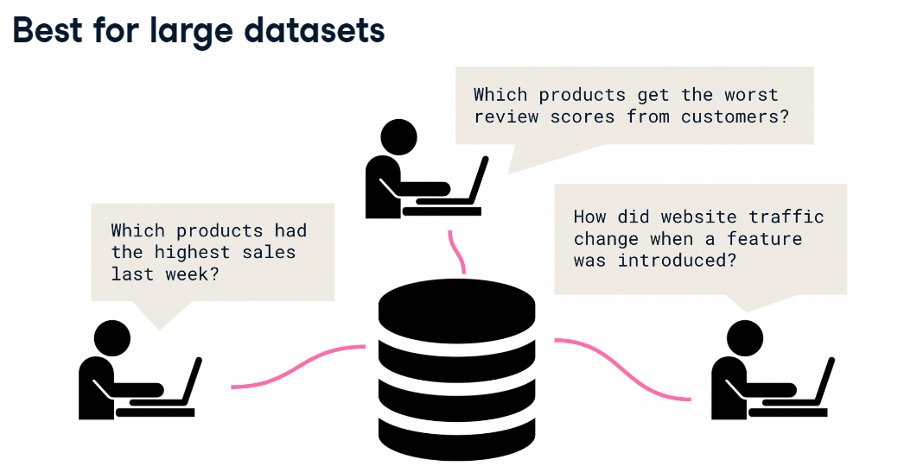

Slide 6
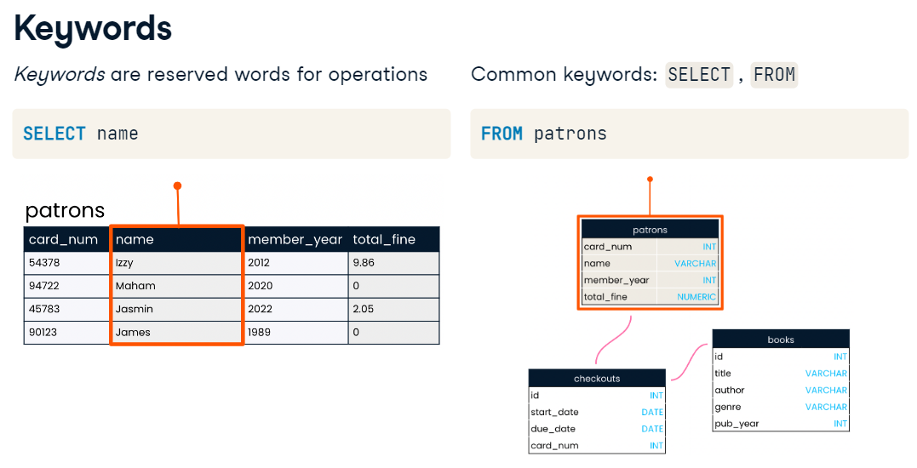

Slide 7
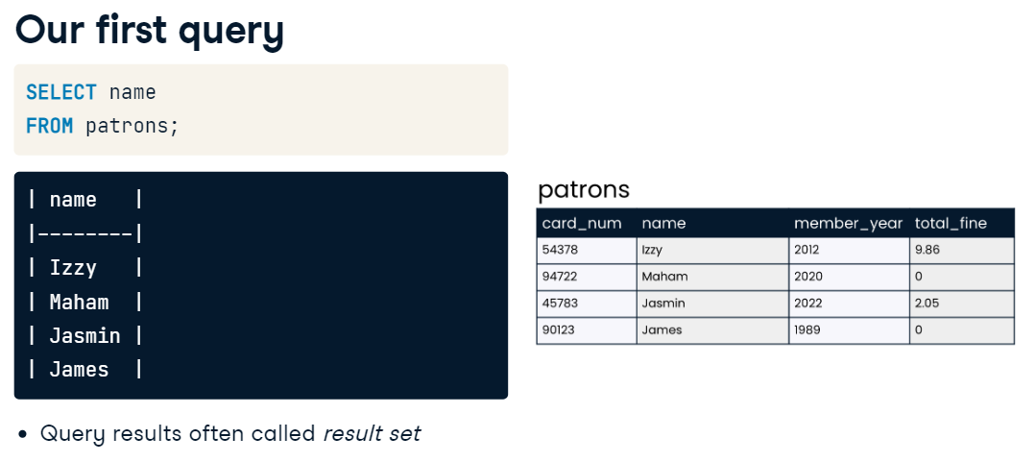

Slide 8
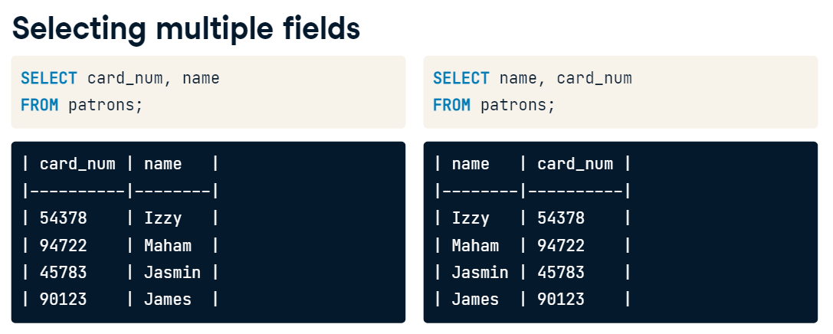

Slide 9
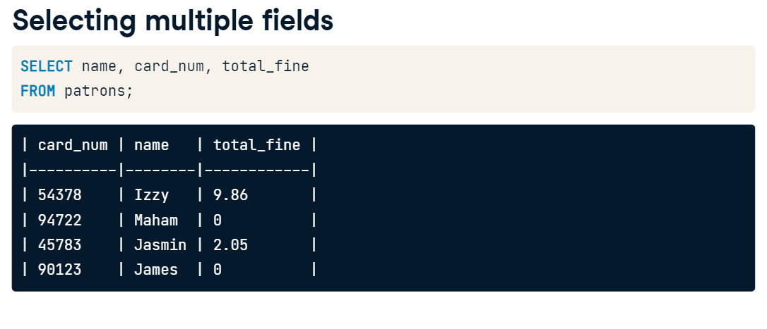

Slide 10
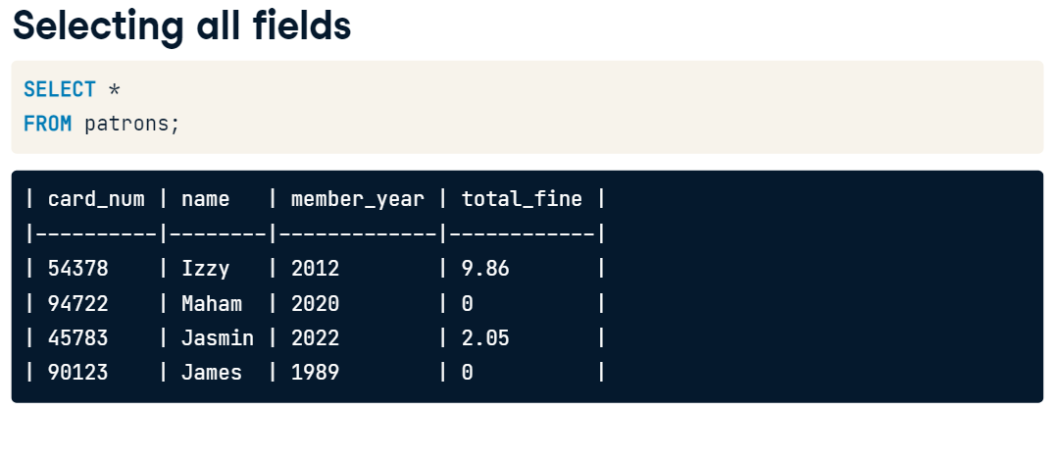

Slide 11


Slide 12


Slide 13
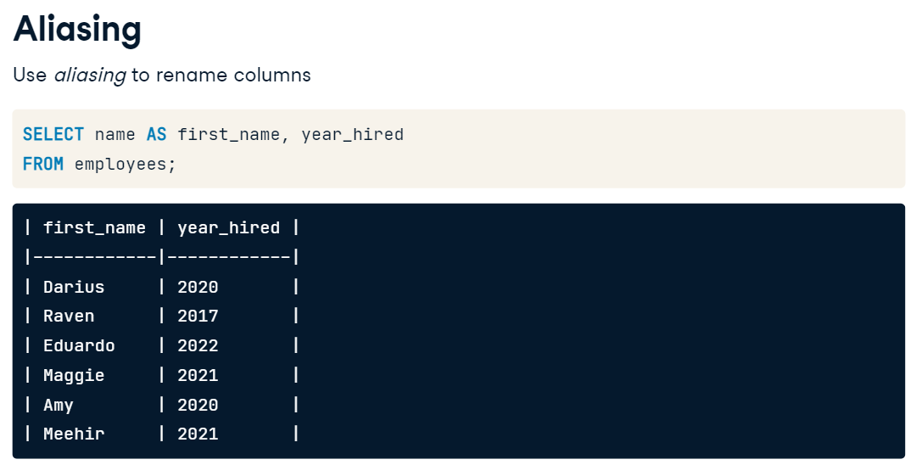

Slide 14
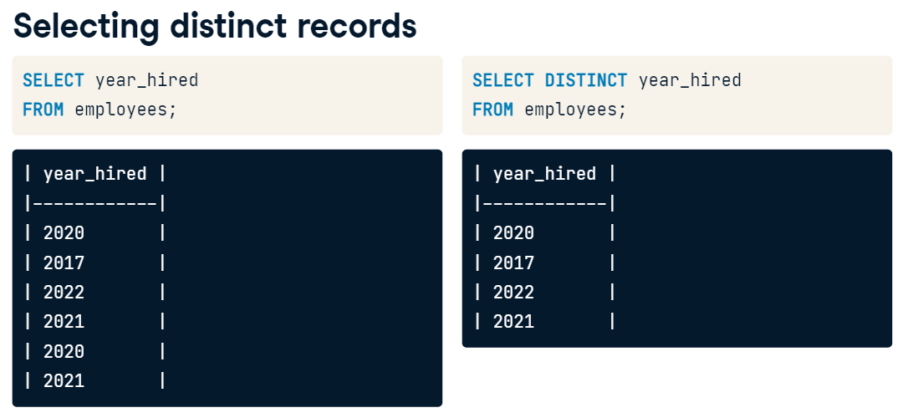

Slide 15
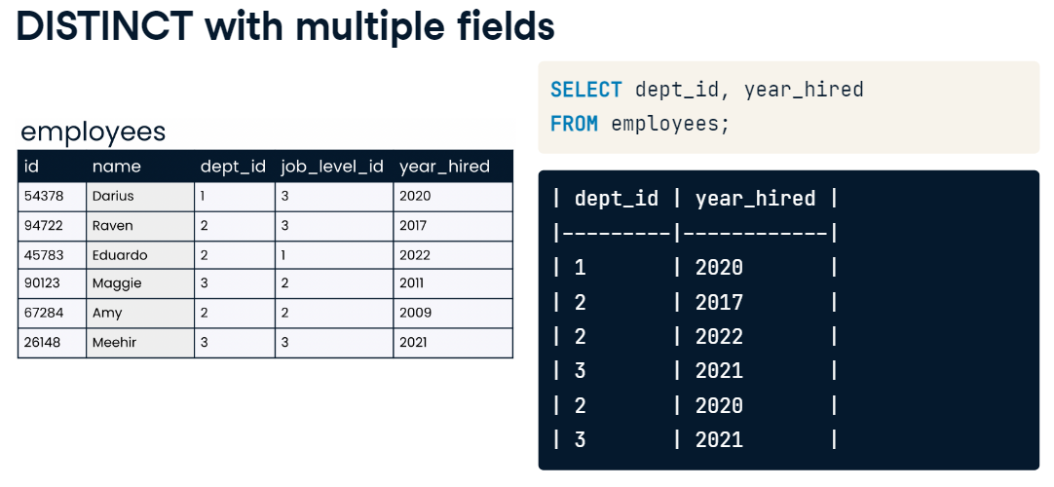

Slide 16
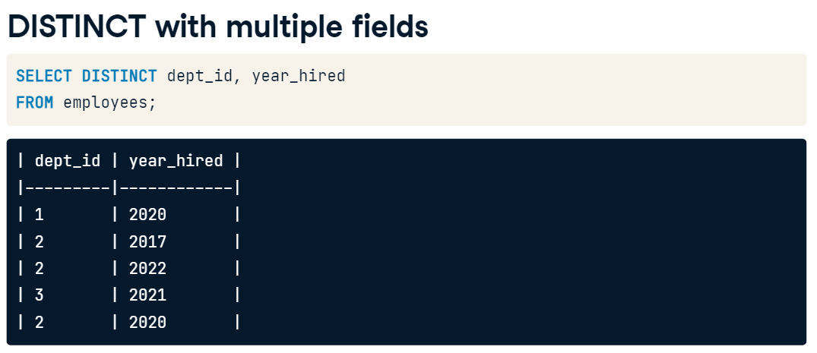

Slide 17
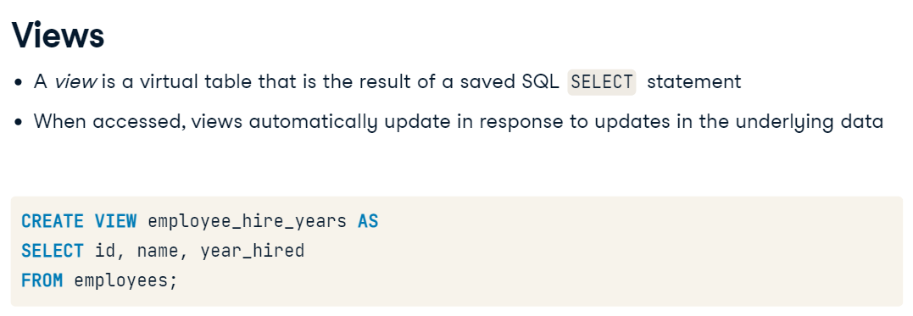

Slide 18
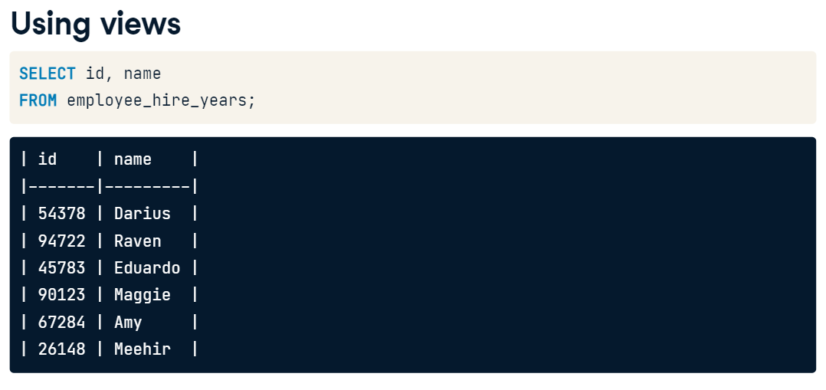

Slide 19


Slide 20


Slide 21


Slide 22
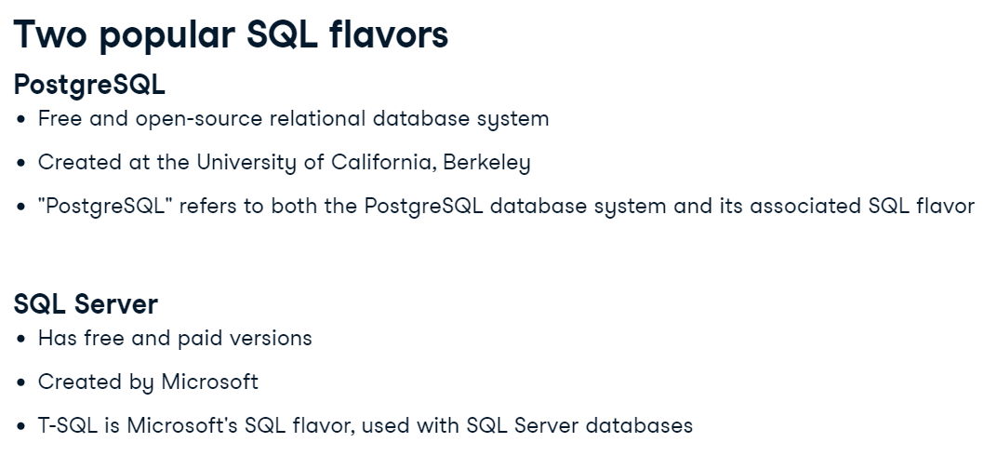

Slide 23
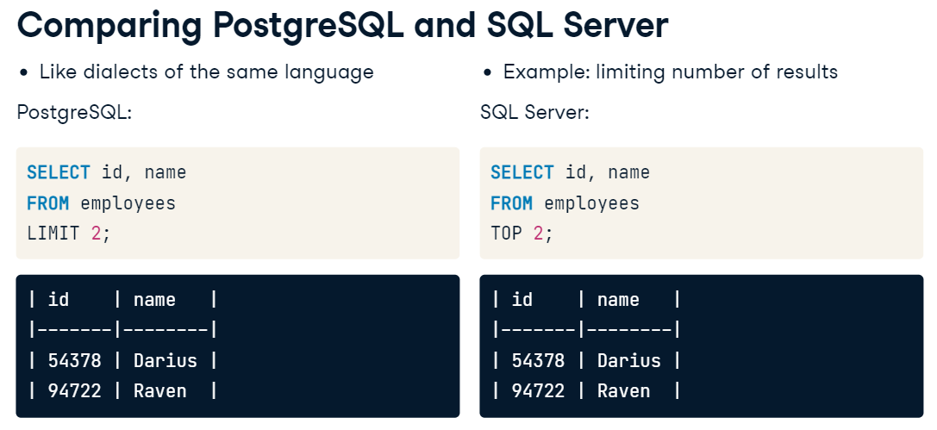

Slide 24


Slide 25


Slide 26
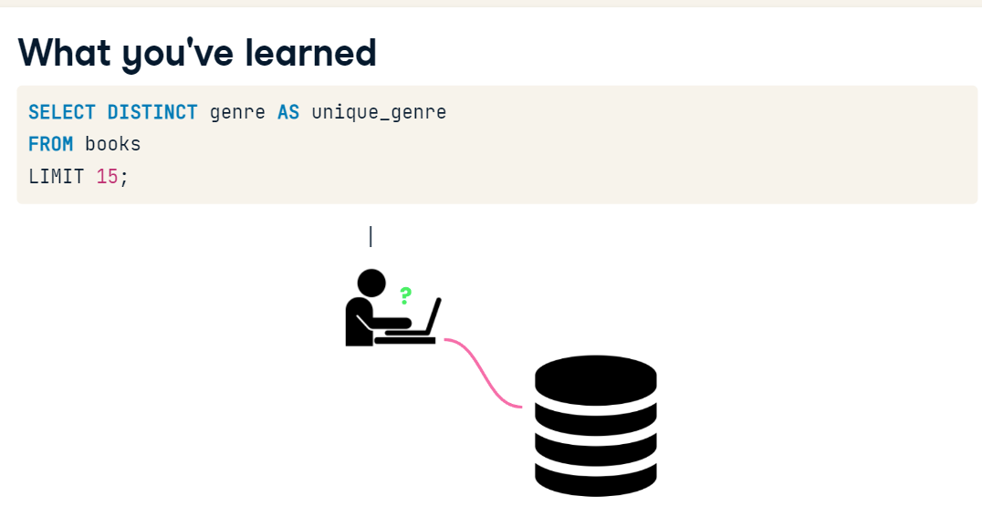

Slide 27
Database Management System
LAB #02

Slide 28
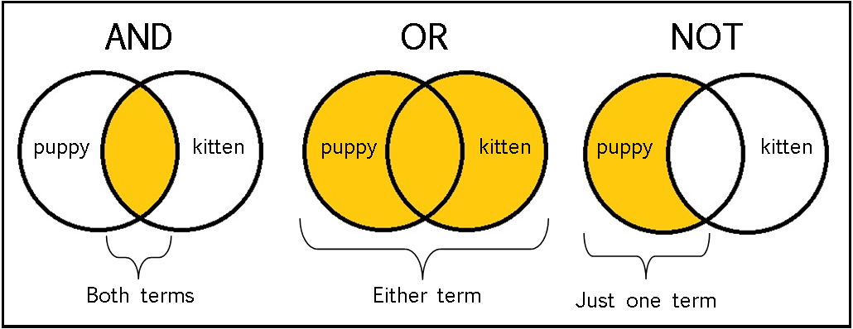
Logical Operators
Logical operators are used to test if a specified condition is true or not. They are also used to combine multiple conditions.
Some of the commonly used logical operators are:
OR → Retrieves rows that meet any one of the specified conditions.
AND →Retrieves rows that meet both the conditions.
NOT → Retrieves rows that do not meet the specified condition.
BETWEEN →Retrieves rows where the tested value falls within the specified range

Slide 29
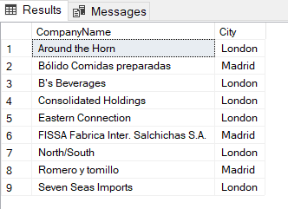

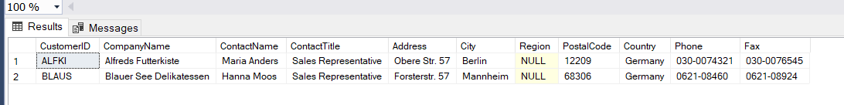
-- (A) OR Operator
SELECT CompanyName,City
FROM Customers
WHERE City = 'London' OR City = 'Madrid';
-- (B) AND Operator
SELECT CompanyName,City,ContactName
FROM Customers
WHERE Country='Germany' AND City='Berlin';
-- (C) Using combination to both AND/OR
SELECT *
FROM Customers
WHERE Country='Germany' AND (City='Berlin' OR City='Mannheim');

Slide 30
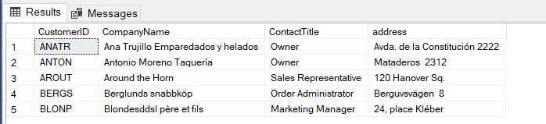
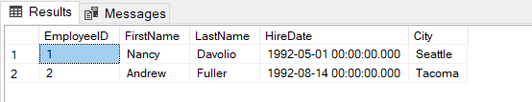
-- NOT operator
SELECT TOP(5) CustomerID, CompanyName, ContactTitle, Address AS address
FROM Customers
WHERE NOT Country='Germany' ;
-- BETWEEN Operator
SELECT EmployeeID, FirstName, LastName, HireDate, City
FROM Employees
WHERE HireDate BETWEEN '1992-05-01 00:00:00.000' AND '1993-05-01 00:00:00.000'

Slide 31
List Operator
The IN list operator checks if the result of the expression meets one of the specified values.
Syntax:
The syntax for using a list operator in a query is:
SELECT column_name(s) FROM table_name
WHERE column_name IN (value1,value2,...);

Slide 32
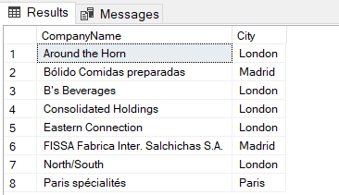
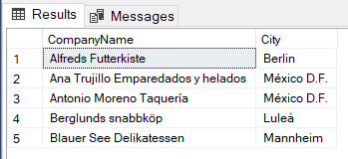
-- IN Operator
SELECT TOP(8) CompanyName,City
FROM Customers
WHERE City IN ('London','Madrid','Paris');
-- NOT IN clause
SELECT TOP(5) CompanyName,City
FROM Customers
WHERE City NOT IN ('London','Madrid','Paris');

Slide 33
NULL Clause
A NULL value in a column means that there is no data in the column. You can retrieve rows which contain NULL values using the IS NULL keyword with the WHERE clause.
Syntax:
The syntax for using a list operator in a query is:
SELECT <column_names>
FROM <table_name>
WHERE <column_name> IS NULL

Slide 34
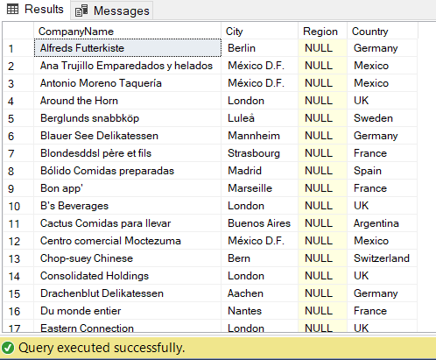
-- NULL Clause
SELECT CompanyName,City,Region,Country
FROM Customers
WHERE REGION IS NULL;

Slide 35
SQL Wildcards
A wildcard character can be used to substitute for any other character(s) in a string.
In SQL, wildcard characters are used with the SQL LIKE operator.
SQL wildcards are used to search for data within a table.
Wildcard | Description
_ (underscore) | matches any single character
% | matches a string of one or more characters
[ ] | matches any single character within the specified range (e.g. [a-f]) or set (e.g. [abcdef]).
[^] | matches any single character not within the specified range (e.g. [^a-f]) or set (e.g. [^abcdef]).

Slide 36
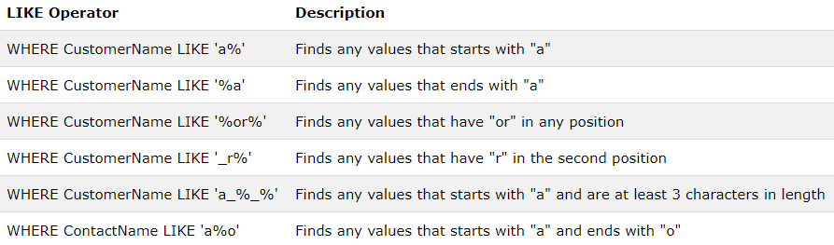
Like operator

Slide 37
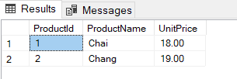
-- WILD CARD
SELECT *
FROM Customers
WHERE City LIKE '_erlin';
SELECT ProductId, ProductName, UnitPrice
FROM Products
WHERE ProductName LIKE 'Cha_' OR ProductName LIKE 'Chan_';

Slide 38
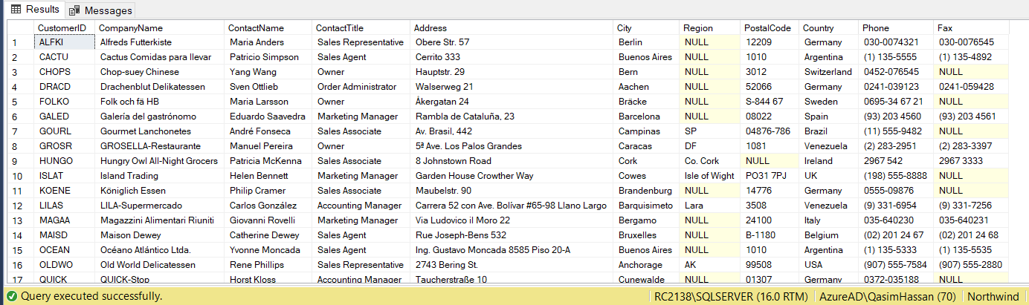
SELECT *
FROM Customers
WHERE City LIKE '[a-c]%';

Slide 39
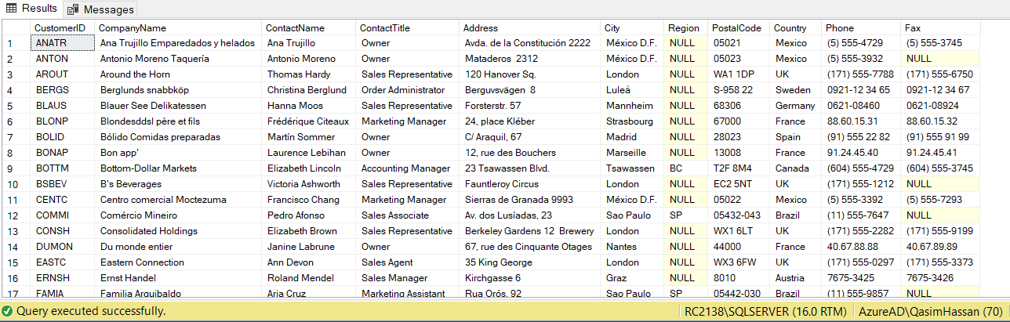
SELECT *
FROM Customers
WHERE City LIKE '[^a-c]%';

Slide 40
SUMMARY:
Comparison Operators (AND, OR, NOT, BETWEEN)
LIST OPERATOR (IN , NOT IN)
NULL CLAUSE (IS NULL, IS NOT NULL)
SQL Wildcard ( _, %, [], [^])

